Slide 1
Memory Management

Slide 2
What is Memory management?
Memory management is the functionality of an operating system which handles or manages primary memory and moves processes back and forth between main memory and disk during execution.
Memory management keeps track of each and every memory location, regardless of either it is allocated to some process or it is free.
It checks how much memory is to be allocated to processes. It decides which process will get memory at what time.
It tracks whenever some memory gets freed or unallocated and correspondingly it updates the status.

Slide 3
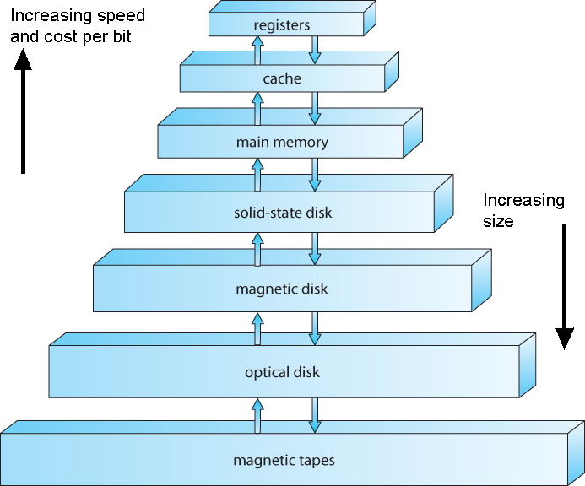
Memory Hierarchy
Memory Hierarchy

Slide 4
Process Address Space
The process address space is the set of logical addresses that a process references in its code.
For example, when 32-bit addressing is in use, addresses can range from 0 to 0x7fffffff; that is, 2^31 possible numbers, for a total theoretical size of 2 gigabytes.
The operating system takes care of mapping the logical addresses to physical addresses at the time of memory allocation to the program.

Slide 5
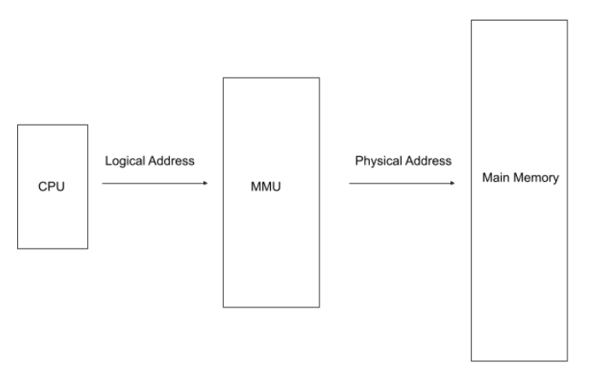

Slide 6
There are three types of addresses used in a program before and after memory is allocated:
Memory Addresses & Description
1 | Symbolic addresses The addresses used in a source code. The variable names, constants, and instruction labels are the basic elements of the symbolic address space.
2 | Relative addresses At the time of compilation, a compiler converts symbolic addresses into relative addresses.
3 | Physical addresses The loader generates these addresses at the time when a program is loaded into main memory.

Slide 7
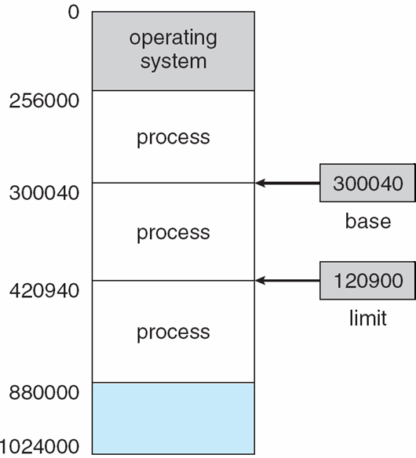
Base and Limit Registers
A pair of base and limit registers define the logical address space
CPU must check every memory access generated in user mode to be sure it is between base and limit for that user

Slide 8
Hardware Address Protection

Slide 9
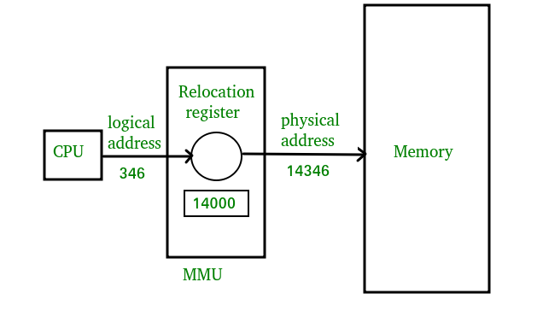

Slide 10
Swapping
Swapping is a mechanism in which a process can be swapped temporarily out of main memory (or move) to secondary storage (disk) and make that memory available to other processes. At some later time, the system swaps back the process from the secondary storage to main memory.
Though performance is usually affected by swapping process but it helps in running multiple and big processes in parallel and that's the reason Swapping is also known as a technique for memory compaction.

Slide 11

Schematic View of Swapping

Slide 12
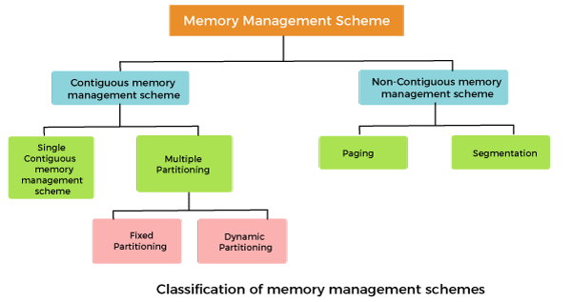
Memory management Techniques:

Slide 13
Contiguous Memory Allocation Types
1. Single-partition allocation
2.Multiple-partition allocation

Slide 14
Single-partition allocation
Low Memory
High Memory
Operating system
Process 1
Free space

Slide 15
Multiple Partition Allocation
Fixed partition
Variable partition
Operating System
Process 1
Process 2
Free space

Slide 16
Fixed Partition
Operating System
Partition 1: 1KB
Partition2: 3KB
Partition3: 5KB
Partition4: 2KB
Unequal size
Operating System
Partition 1: 1KB
Partition2: 1KB
Partition3: 1KB
Partition4: 1KB
Equal size

Slide 17
Variable Partition/Dynamic Partition
Operating System
Partition 1: 1KB
Partition2: 4KB
Partition3: 2KB
Partition4: 3KB
Partition:5 5KB

Slide 18
Algorithms for memory allocation
First fit
Best fit
Worst fit

Slide 19
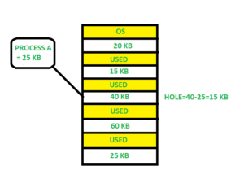
First fit
In the first fit, the partition is allocated which is the first sufficient block from the top of Main Memory. It scans memory from the beginning and chooses the first available block that is large enough. Thus it allocates the first hole that is large enough.

Slide 20
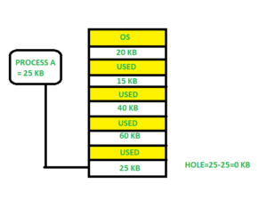
Best fit
Allocate the process to the partition which is the first smallest sufficient partition among the free available partition. It searches the entire list of holes to find the smallest hole whose size is greater than or equal to the size of the process.

Slide 21
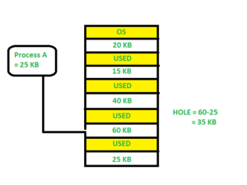
Worst fit
Allocate the process to the partition which is the largest sufficient among the freely available partitions available in the main memory. It is opposite to the best-fit algorithm. It searches the entire list of holes to find the largest hole and allocate it to process.

Slide 22
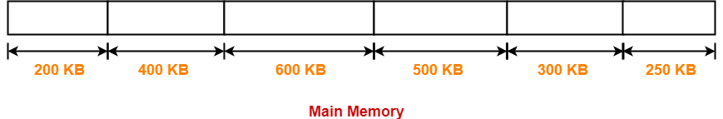
Consider six memory partitions of size 200 KB, 400 KB, 600 KB, 500 KB, 300 KB and 250 KB. These partitions need to be allocated to three processes of sizes 357 KB, 210 KB, and 468 KB in that order. Perform the allocation of processes using-
First Fit Algorithm
Best Fit Algorithm
Worst Fit Algorithm
According to question,
The main memory has been divided into fixed size partitions as-

Slide 23
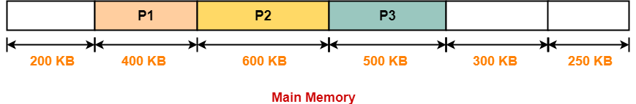
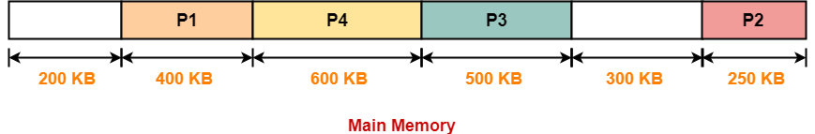
First fit
Best fit

Slide 24
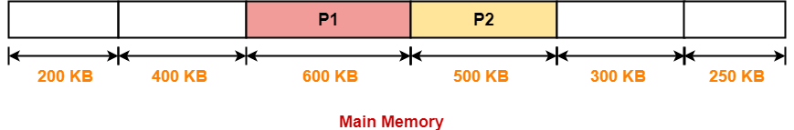
Worst fit
Process P3 and Process P4 can not be allocated the memory.
This is because no partition of size greater than or equal to the size of process P3 and process P4 is available.

Slide 25
Fragmentation
Refers to an unwanted problem that occurs in the OS in which a process is unloaded and loaded from memory, and the free memory space gets fragmented.
The processes can not be assigned to the memory blocks because of their small size. Thus the memory blocks always stay unused

Slide 26
Fragmentation
Fragmentation is of two types:
External fragmentation
Internal fragmentation

Slide 27
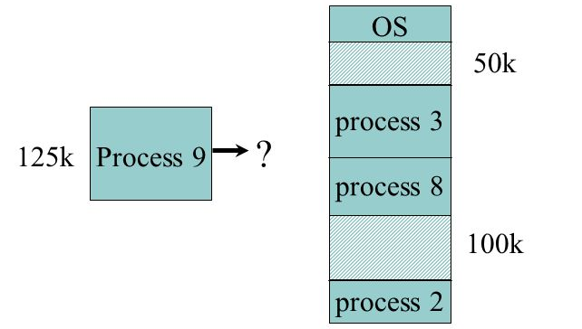
External Fragmentation
External fragmentation occurs whenever a method of dynamic memory allocation happens to allocate some memory and leave a small amount of unusable memory. The total quantity of the memory available is reduced substantially in case there’s too much external fragmentation. So, there’s enough memory space in order to complete a request, and it is not contiguous. Thus, it is known as external fragmentation.

Slide 28
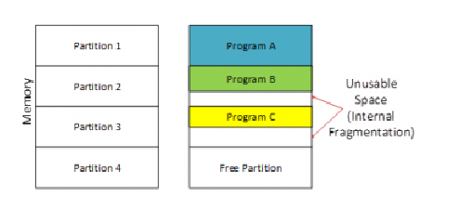
Internal fragmentation
Whenever a memory block gets allocated with a process, and in case the process happens to be smaller than the total amount of requested memory, a free space is ultimately created in this memory block. And due to this, the memory block’s free space is unused. This is what causes internal fragmentation.

Slide 29
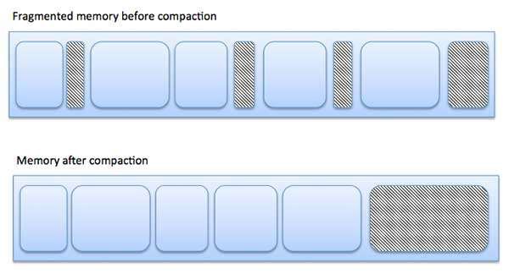
Fragmentation (Cont.)
External fragmentation can be reduced by compaction or shuffle memory contents to place all free memory together in one large block. To make compaction feasible, relocation should be dynamic.
The internal fragmentation can be reduced by effectively assigning the smallest partition but large enough for the process

Slide 30
Non contiguous memory allocation techniques
In non-contiguous memory allocation, different parts of a process are allocated to different places in Main Memory
There are five types of Non-Contiguous Allocation of Memory in the Operating System:
Paging
Multilevel Paging
Inverted Paging
Segmentation
Segmented Paging

Slide 31
Segmentation
Segmentation is a memory management technique in which each job is divided into several segments of different sizes, one for each module that contains pieces that perform related functions. Each segment is actually a different logical address space of the program.
When a process is to be executed, its corresponding segments are loaded into noncontiguous memory though every segment is loaded into a contiguous block of available memory.
Segmentation memory management works very similar to paging but here segments are of variable-length where as in paging pages are of fixed size.

Slide 32
Segmentation
Segmentation is a memory-management scheme that supports the programmer view of memory.
A logical address space is a collection of segments.
Each segment has a name and a length. The addresses specify both the segment name and the offset within the segment. The programmer therefore specifies each address by two quantities: a segment name and an offset.

Slide 33
Logical View of Segmentation
1
1
4
2
3
4
2
3
user space
physical memory space

Slide 34
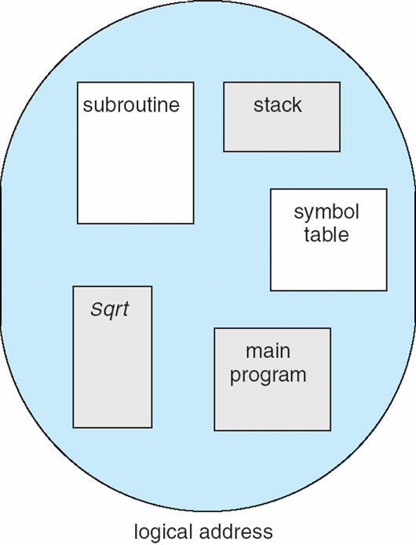
User’s View of a Program

Slide 35
For simplicity of implementation, segments are numbered and are referred to by a segment number, rather than by a segment name. Thus, a logical address consists of a two tuple:
<segment-number, offset>.
A C compiler might create separate segments for the following:
1. The code
2. Global variables
3. The heap, from which memory is allocated
4. The stacks used by each thread
5. The standard C library

Slide 36
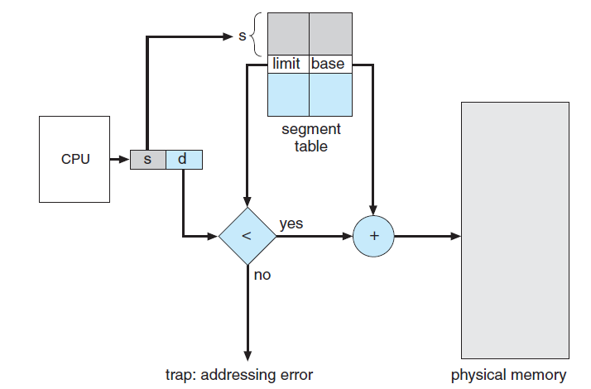
Segmentation Hardware
The segment base contains the starting physical address where the segment resides in memory, and
The segment limit specifies the length of the segment.

Slide 38
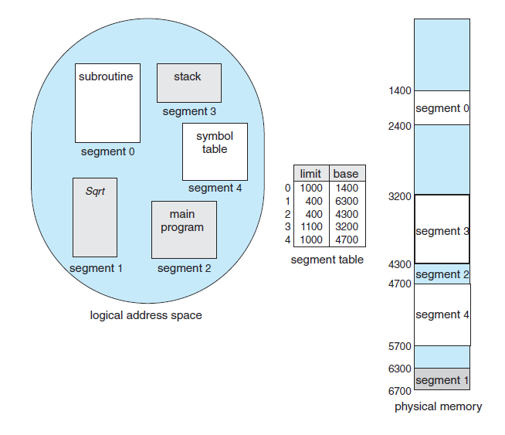
Segmentation Example

Slide 39
For example, segment 2 is 400 bytes long and begins at location 4300. Thus, a reference to byte 53 of segment 2 is mapped onto location 4300 + 53 = 4353.
A reference to segment 3, byte 852, is mapped to 3200 (the base of segment 3) + 852 = 4052.
A reference to byte 1222 of segment 0 would result in a trap to the operating system, as this segment is only 1,000 bytes long.

Slide 40
Advantages of Segmentation
No internal fragmentation
Less overhead
It is easier to relocate segments than entire address space.
Disadvantages
It can have external fragmentation.
it is difficult to allocate contiguous memory to variable sized partition.
Costly memory management algorithms.

Slide 41
Consider the following segment table-
Segment No. | Base | Length
0 | 1219 | 700
1 | 2300 | 14
2 | 90 | 100
Calculate the physical address for the following logical address?
0, 430
1, 11
2, 100
Segment Offset must always lie in the range [0, limit-1].
If segment offset becomes greater than or equal to the limit of segment, then trap addressing error is produced.
1. Physical Address = 1219 + 430 = 1649, as 430 <(700-1)
2. Physical Address =2300+11=2311 as 11<(14-1)
3. In the segment table, limit of segment-2 is 100.
Thus, segment offset must always lie in the range = [0, 100-1] = [0, 99]
Since generated segment offset does not lie in the above range, so request generated is invalid. Therefore, trap will be produced.

Slide 42
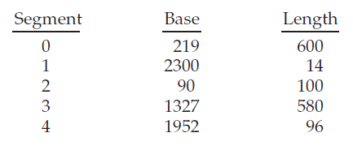
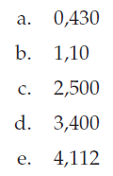
Assignment
Consider the following segment table:
What are the physical addresses for the following logical addresses?

Slide 43
Paging
A computer can address more memory than the amount physically installed on the system.
This extra memory is actually called virtual memory and it is a section of a hard that's set up to emulate the computer's RAM.
Paging technique plays an important role in implementing virtual memory.

Slide 44
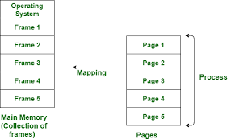

Slide 45
Paging is a memory management technique in which process address space is broken into blocks of the same size called pages (size is power of 2, between 512 bytes and 8192 bytes). The size of the process is measured in the number of pages.
Similarly, main memory is divided into small fixed-sized blocks of (physical) memory called frames and the size of a frame is kept the same as that of a page to have optimum utilization of the main memory and to avoid external fragmentation.

Slide 46
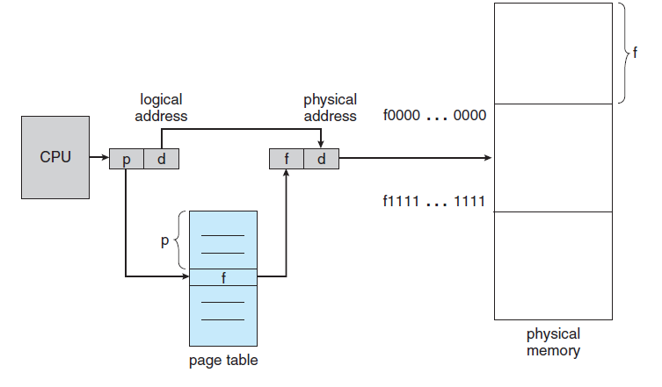
Page map table

Slide 47
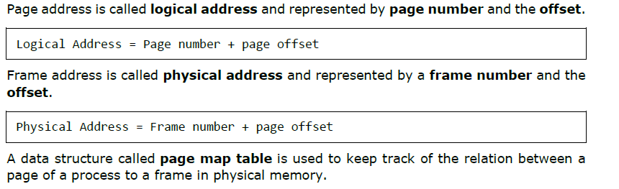
Address Translation

Slide 48
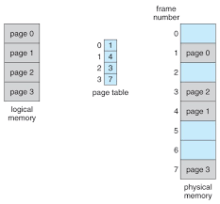
Paging model of logical and physical memory.

Slide 49
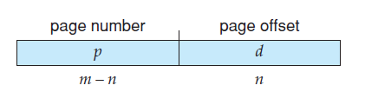
If the size of the logical address space is 2^m, and a page size is 2^n bytes, then the high-order m− n bits of a logical address designate the page number, and the n low-order bits designate the page offset. Thus, the logical address is as follows:
where p is an index into the page table and d is the displacement within the page.

Slide 50
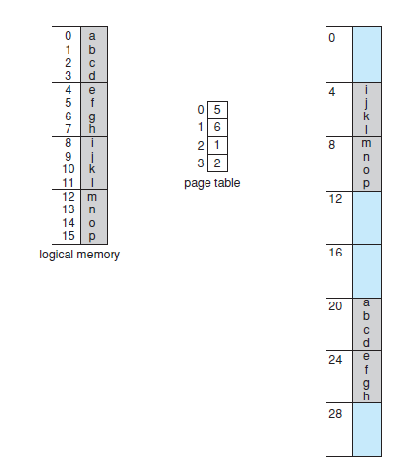
Paging example for a 32-byte memory with 4-byte pages.
Here, in the logical address, n= 2 and m = 4. Using a page size of 4 bytes and a physical memory of 32 bytes (8 pages),
Physical address = Fn*frame size +offset

Slide 51
Logical address 0 is page 0, offset 0. Indexing into the page table, we find that page 0 is in frame 5. Thus, logical address 0 maps to physical address 20 [= (5 × 4) +0].
Logical address 3 (page 0, offset 3) maps to physical address
23 [= (5 × 4) +3].
Logical address 4 is page 1, offset 0; according to the page table, page 1 is mapped to frame 6. Thus, logical address 4 maps to physical address
24 [= (6 × 4) + 0].
Logical address 13 maps to physical address 9.

Slide 52
Assuming a 1-KB page size, what are the page numbers and offsets for the following address references (provided as decimal numbers):
a. 3085
b. 42095
c. 215201
d. 650000
e. 2000001

Slide 53
Page number = logical address / page size
Offset = logical address mod page size

Slide 54
page size = 1 KB = 1024 B
Page Number | offset
3085/1024 = 3 | 3085 mod 1024 = 13
42095/1024 = 41 | 42095 mod 1024 = 111
2000001/1024 = 1953 | 2000001 mod 1024 = 129

Slide 55
2. Consider a logical address space of 256 pages with a 4-KB page size,mapped onto a physical memory of 64 frames.
a. How many bits are required in the logical address?
b. How many bits are required in the physical address?
Let x be the number of physical addresses
Physical address space (/size) = 2^x
Physical address space (size) = # of frames × frame size
Physical address space (size) = 64 × 4 KB
Physical address space (size) = 64 × 4096
Physical address space (size) = 2^6 × 2^12 = 2^18
Number of required bits in the physical address=x =18 bit
Logical address space (/size) = # of pages × page size
Logical address space (/size) = 256 × 4 KB
Logical address space (/size) = 256 × 4096
Logical address space (/size) = 1048576
Logical address space (/size) = 2^20

Slide 56
Advantages and Disadvantages of Paging
Paging reduces external fragmentation, but still suffer from internal fragmentation.
Paging is simple to implement and assumed as an efficient memory management technique.
Due to equal size of the pages and frames, swapping becomes very easy.
Page table requires extra memory space, so may not be good for a system having small RAM.

Slide 57
Thank you

